Slide 1

Machine Learning and Predictions
The original Group four

Slide 2
Team Group 4
Stuart Hunter
Shahrzad Khoobyari
Michelle Taymuree
Victor Tran
Pooja Verma

Slide 3
Final Project Overview
Can we predict sales from Rossman stores?
Exploratory data analysis and Apply different Machine learning models
Analyze results

Slide 4
Exploratory Data Analysis (EDA)
12 Data Features Examined
Day of Week, Month, Customers, Open, School Holidays, Competition Distance, Competition Open Since Month, Competition Open Since Year, Promo, Promo 2, Public Holiday

Slide 5
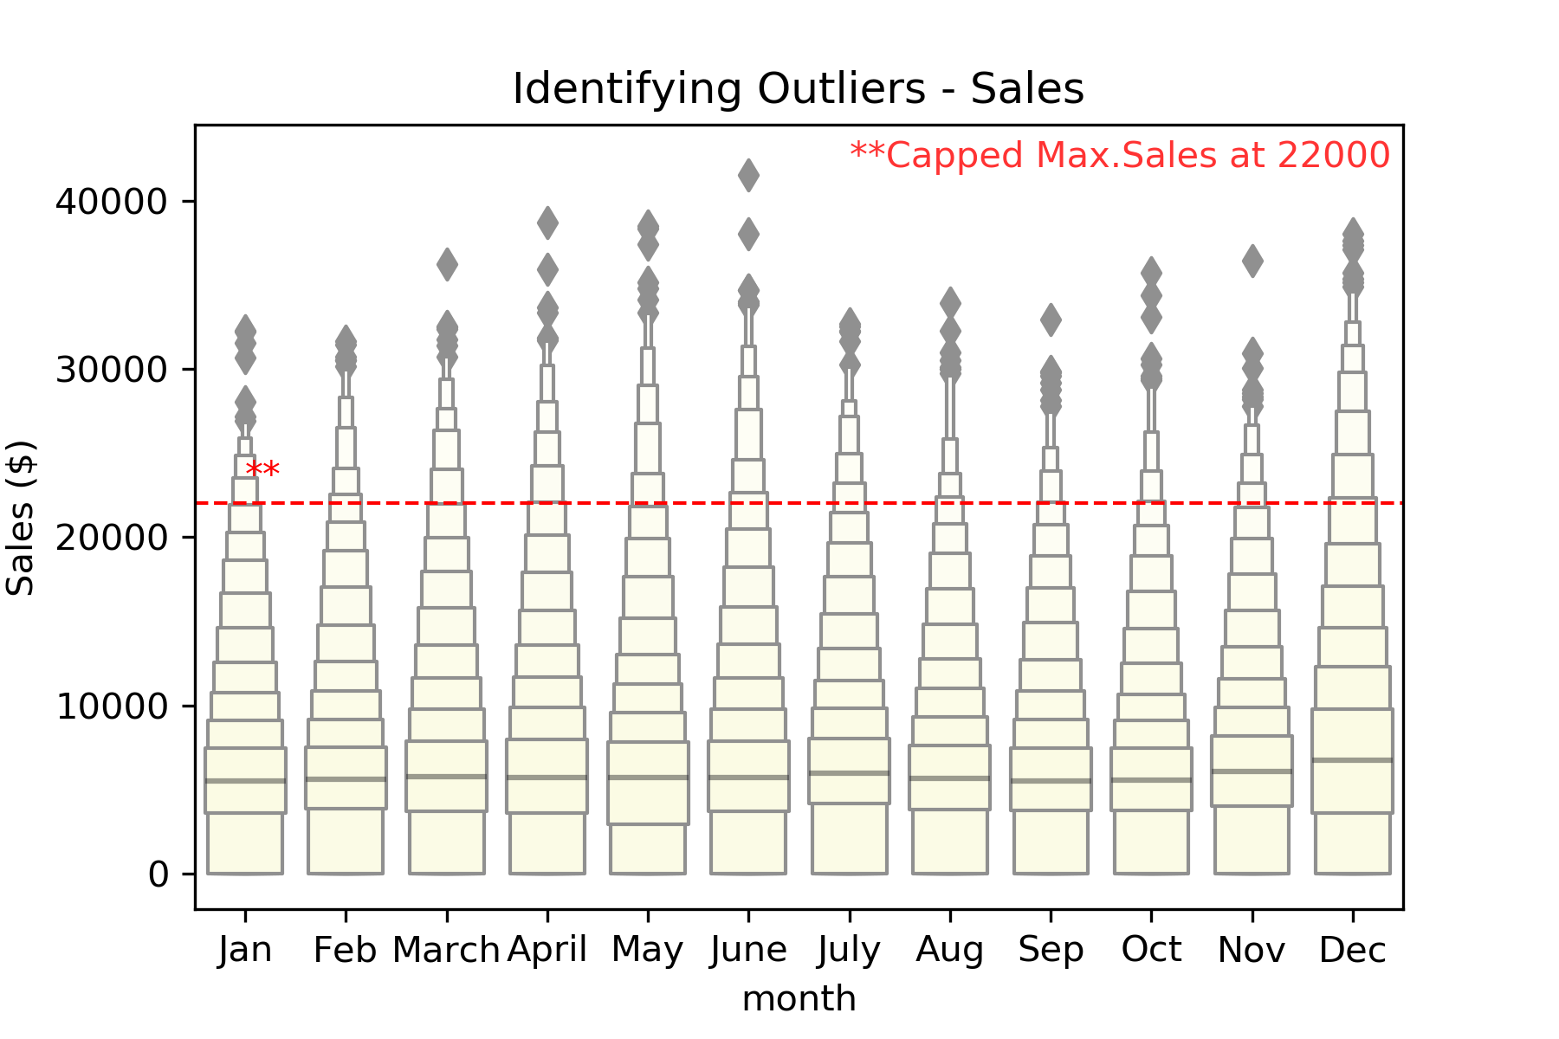
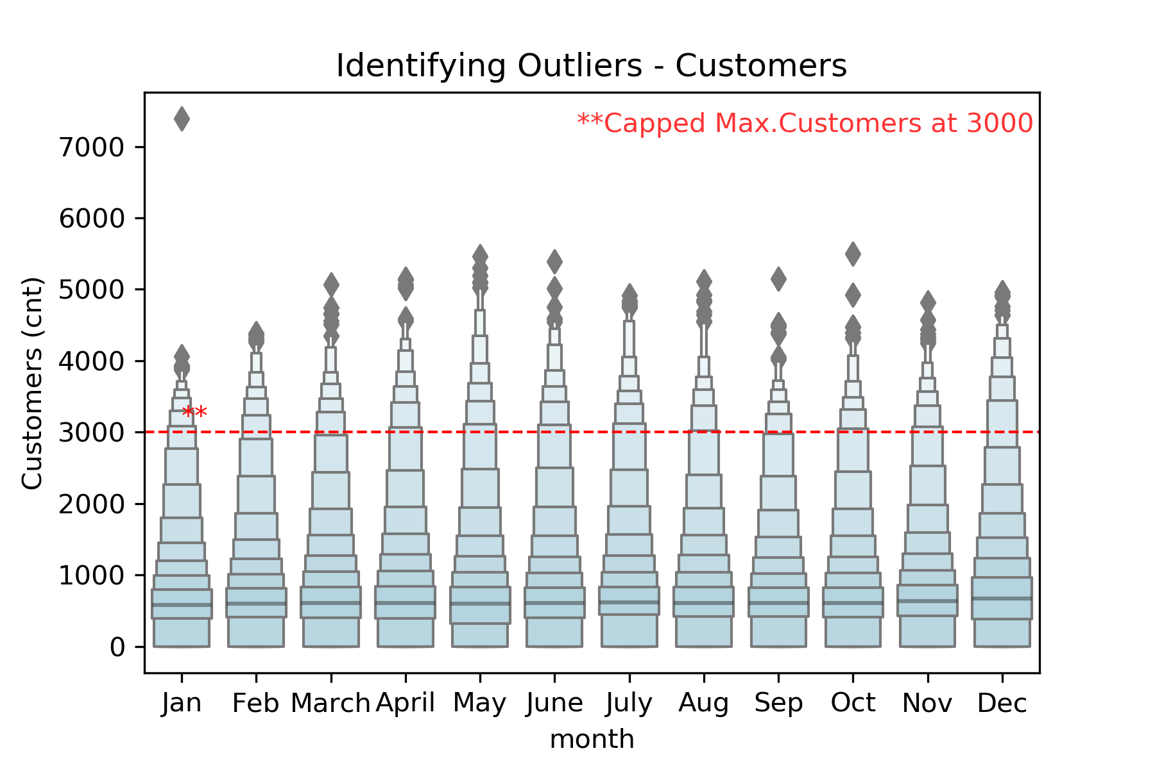
Exploratory Data Analysis
Identified Outliers
Sales capped at $22k
Customers capped at 3K

Slide 6
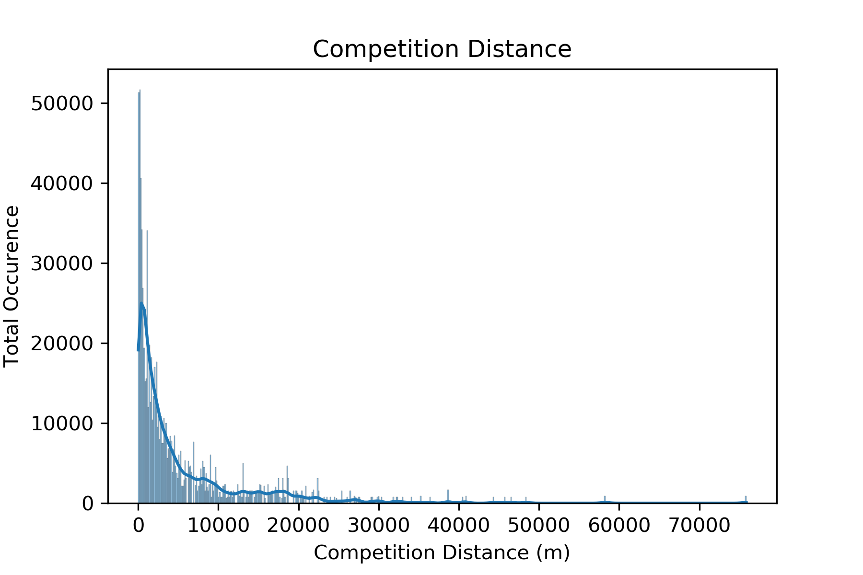
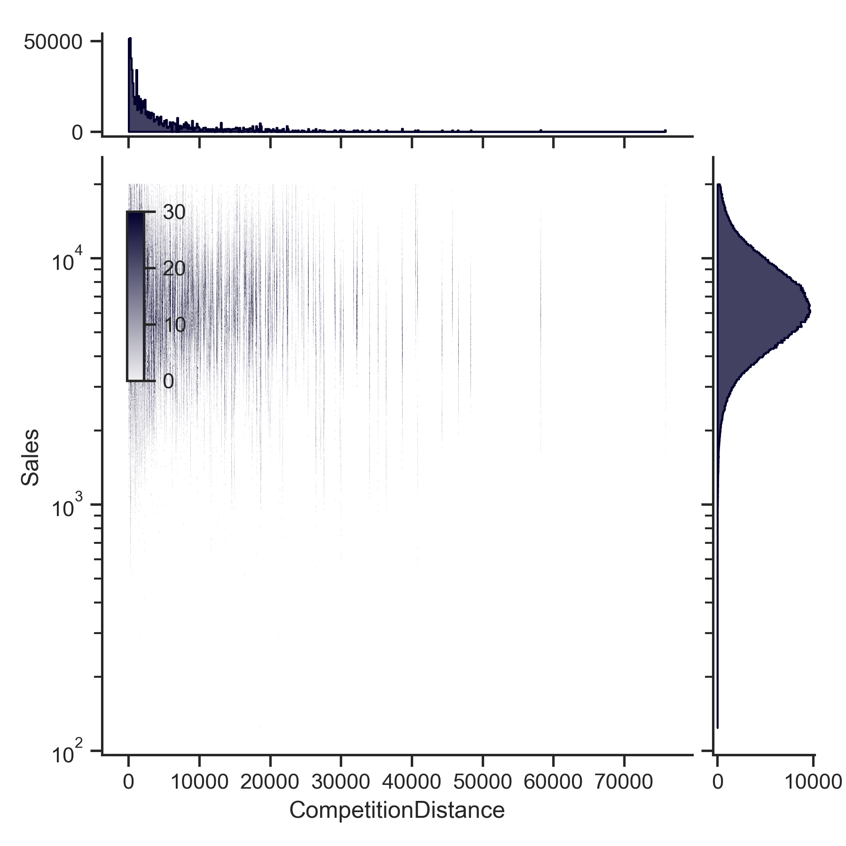
EDA: Analyzed total purchases with respect to competition distance
Normal distribution in maximum daily sales with respect to competition distance

Slide 7
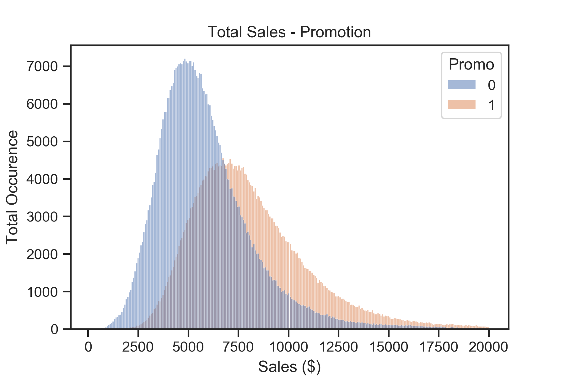
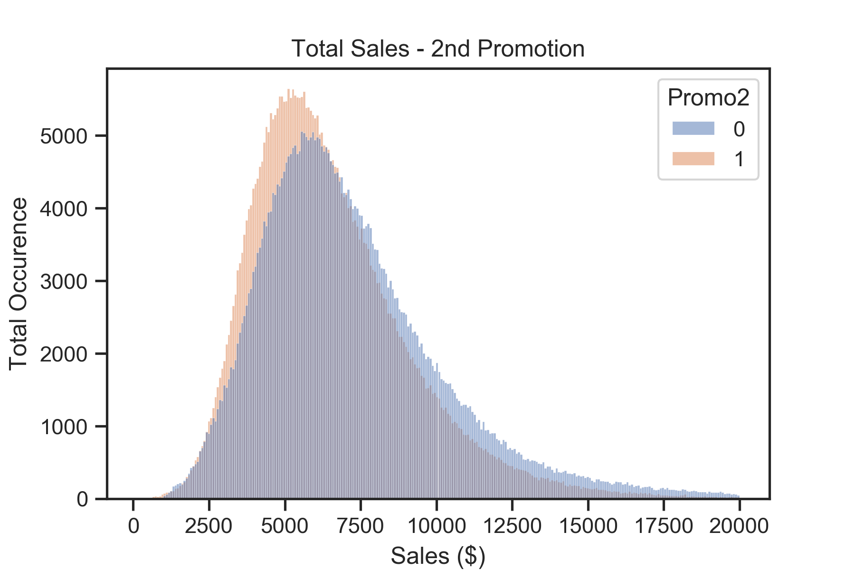
0 – No Promotion
1 - Promotion
EDA: Promotions and Purchases
Having a promotion encouraged larger purchases
A second promotion did not necessarily encourage the same spending behavior

Slide 8
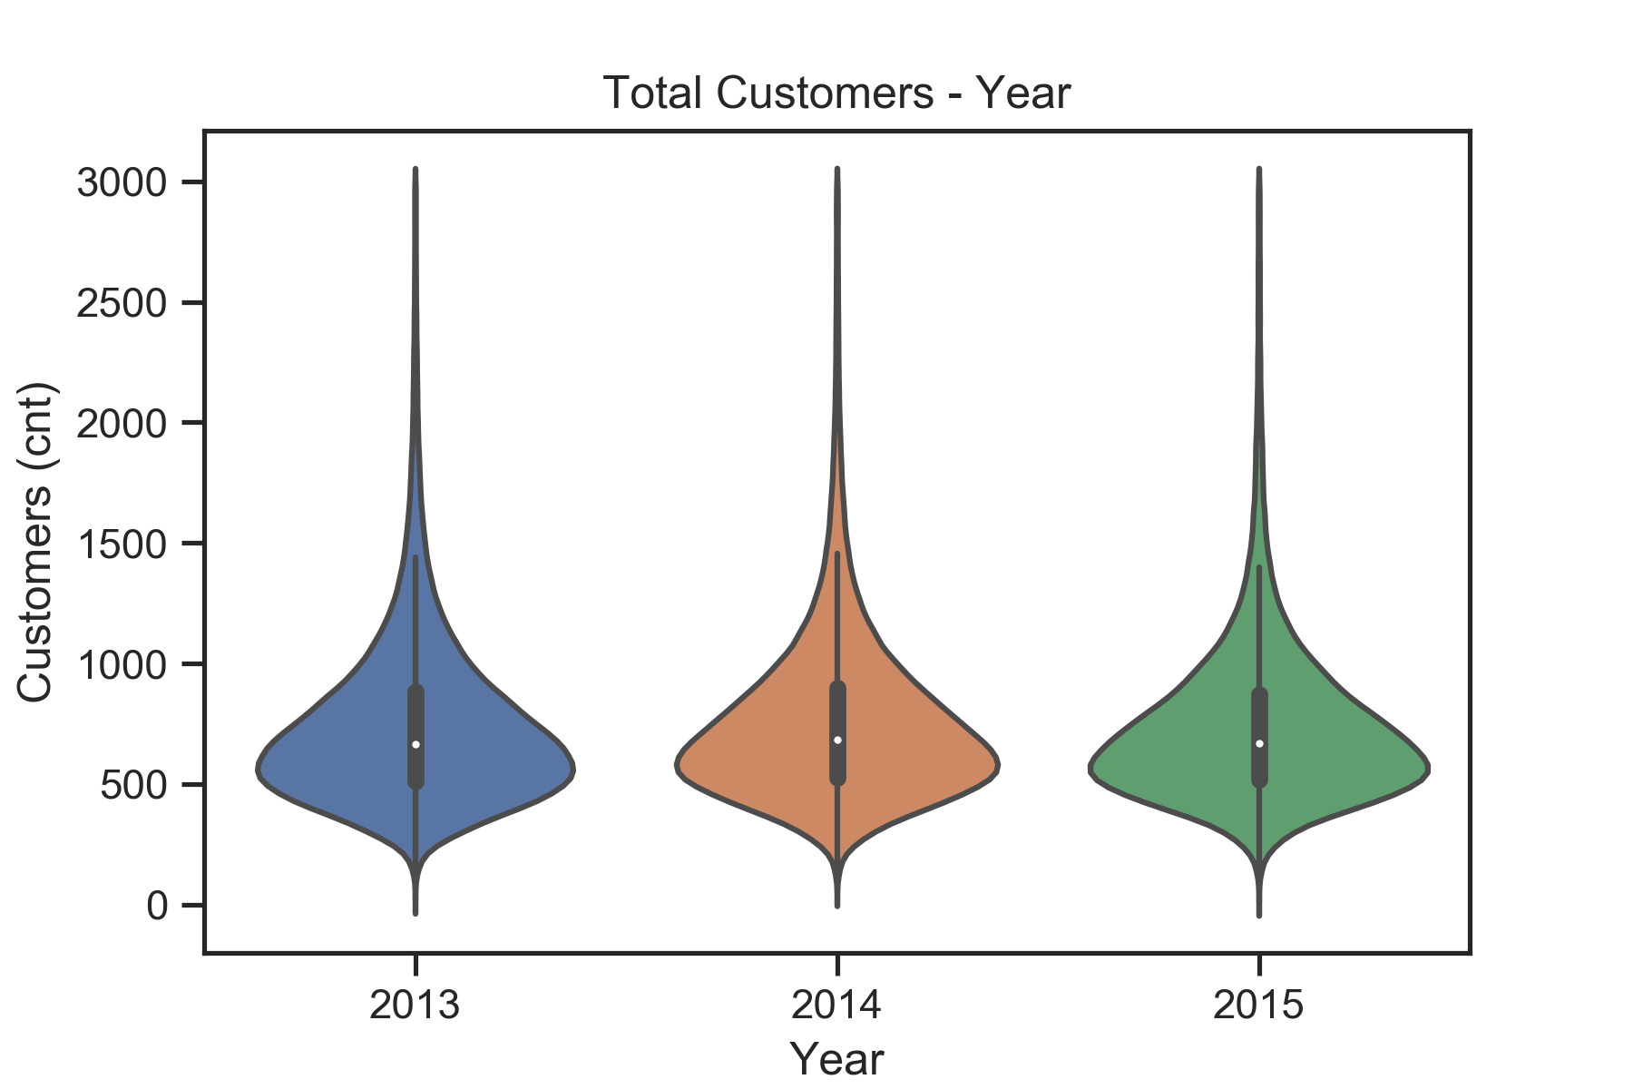
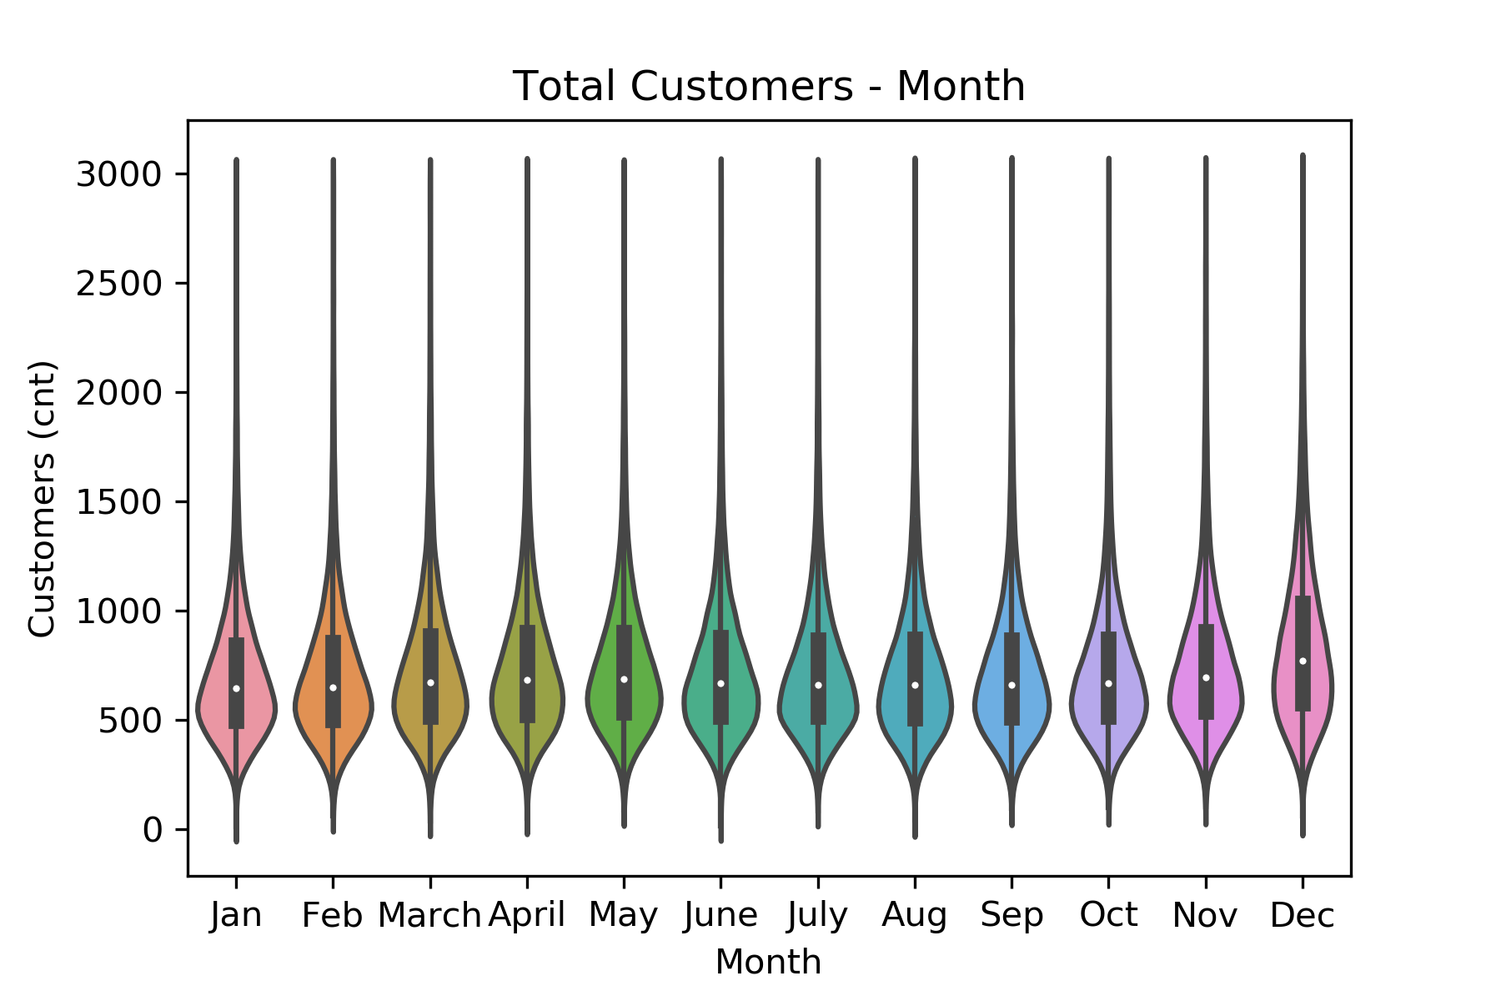
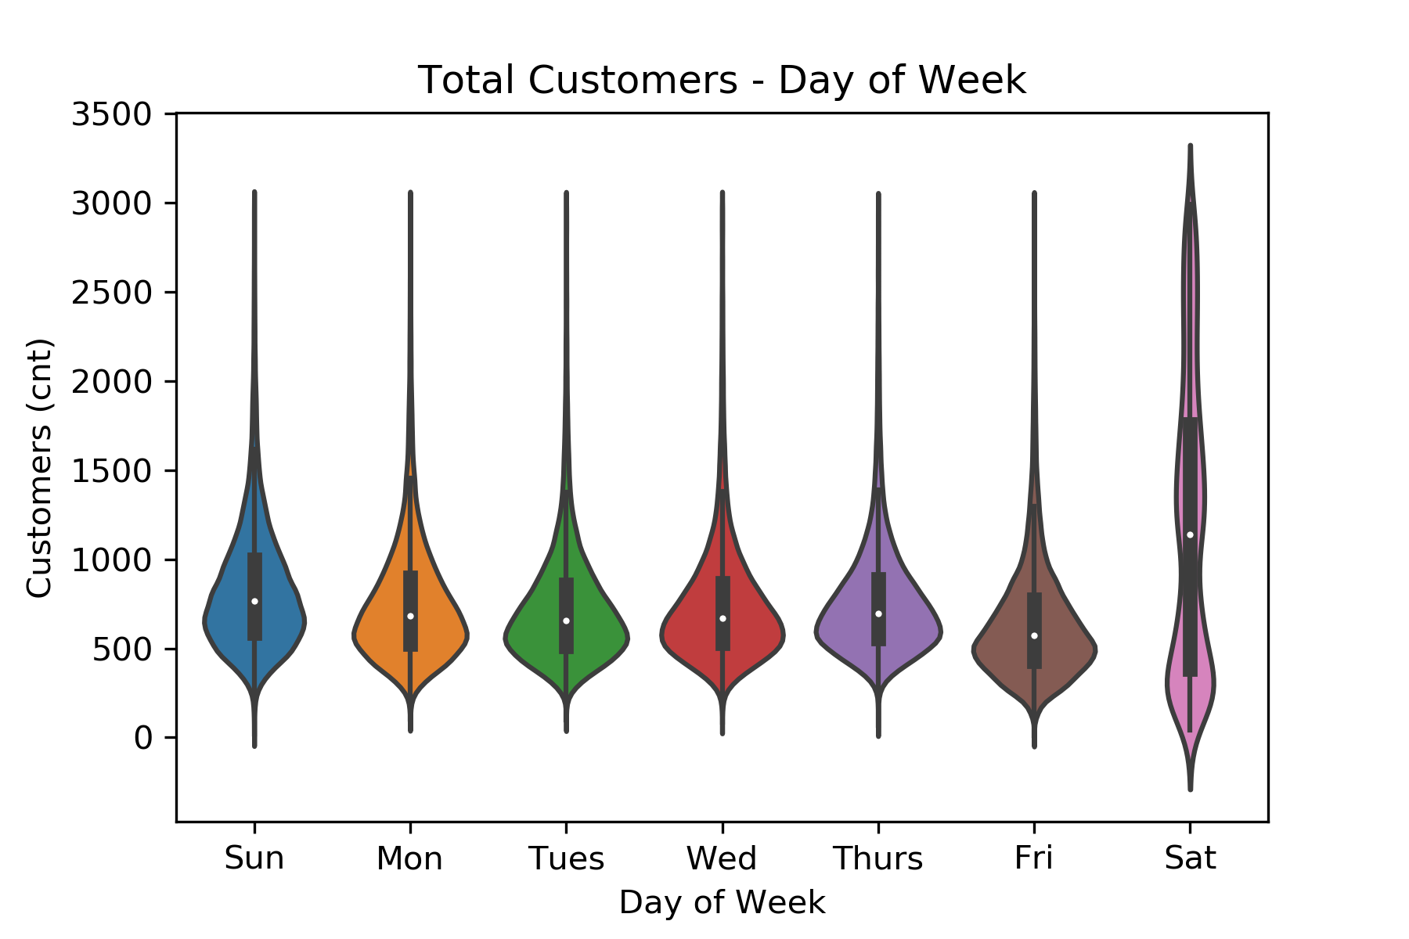
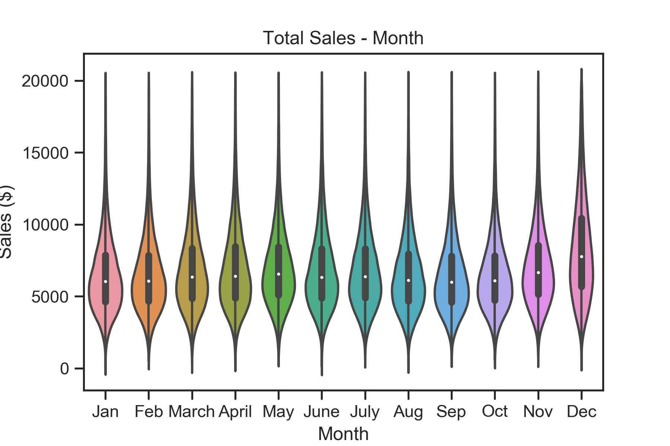
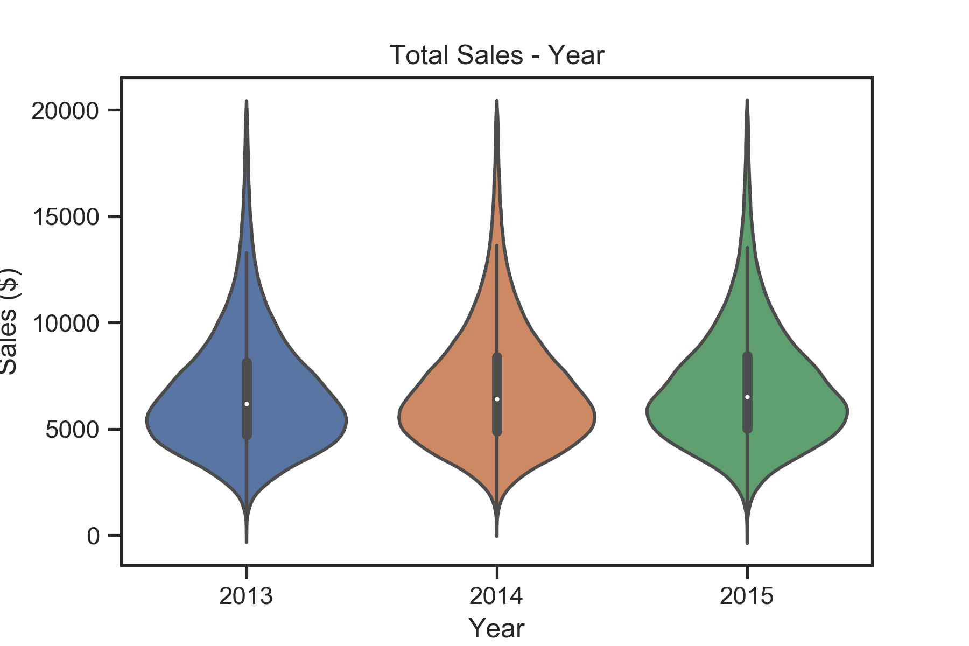
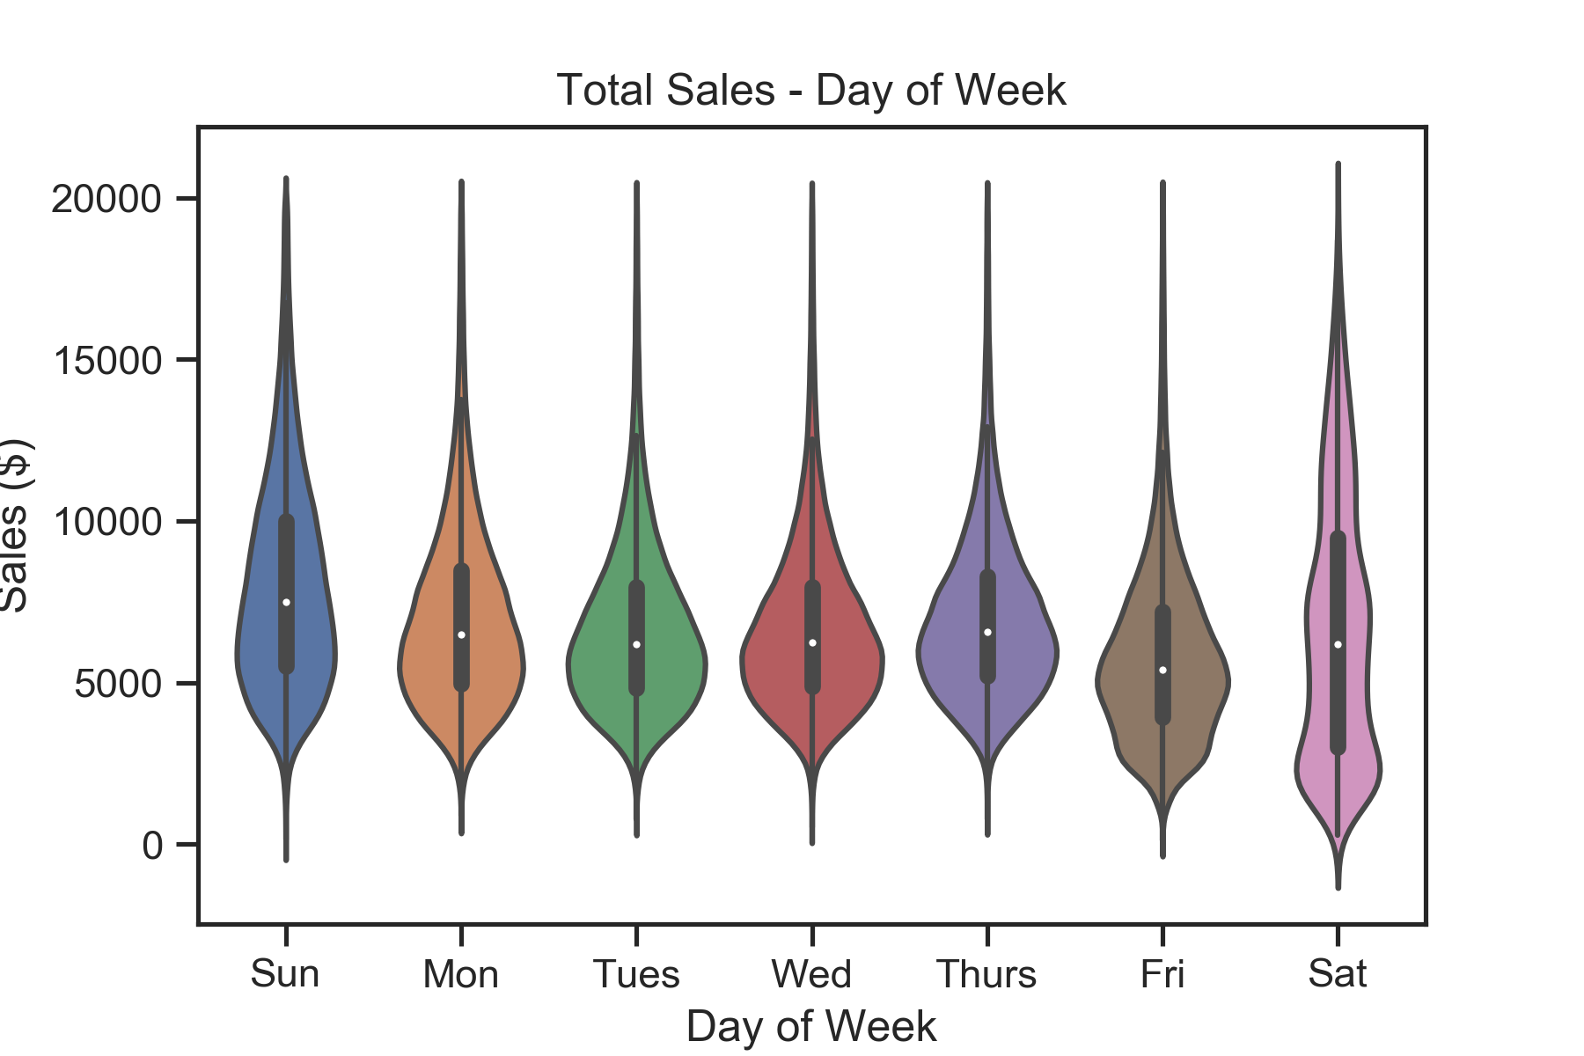
EDA: Analyzed total purchased with respect to units of time (year, month and day of week)

Slide 9
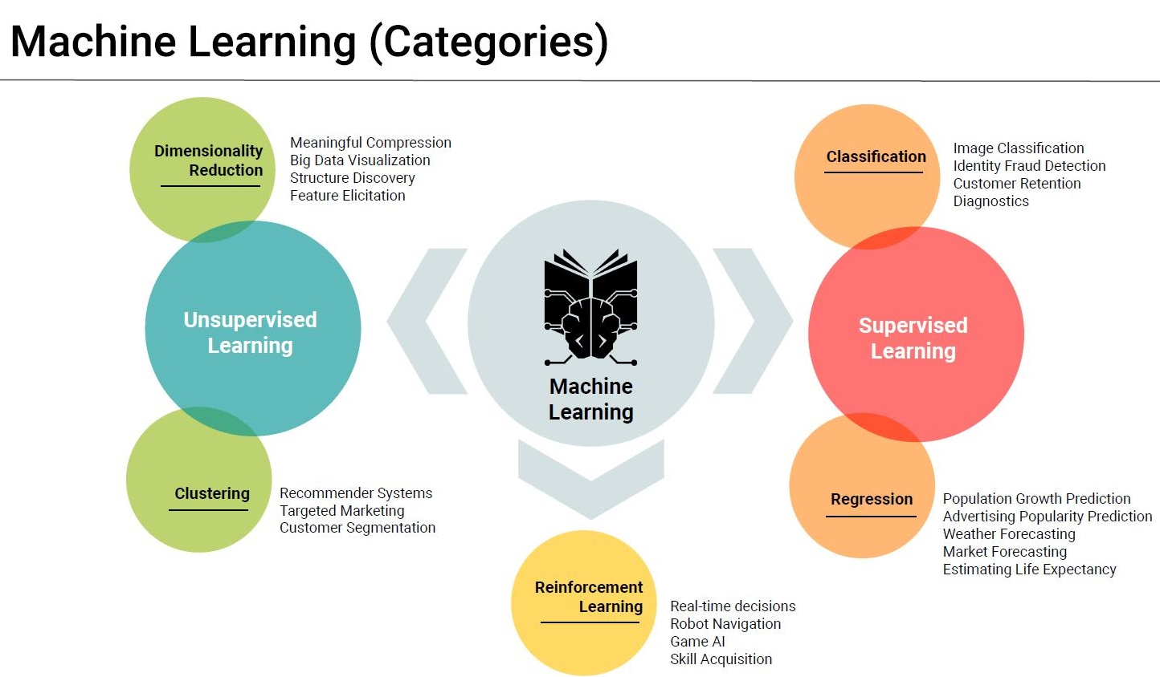
Regression
Commonly used for:
-Market forecasting
-Predicting future revenue
For our data set, we used regression to make a prediction on an output value given a new input

Slide 10
Rossman Sales Data and Machine Learning
Rossman is a large drug store chain in Europe
Given sales and store data, could we use Machine Learning to predict future revenue?
Data: Looked at 12 key features from exploratory analysis
Data source: Kaggle.com

Slide 11
The Set-Up: Machine Learning Models
Compared the performance of the following machine learning models from Sklearn’s libraries
Multiple LinearRegression
Lasso
Ridge
ElasticNet
For each model, compare the data preprocessed using StandardScaler to data without using StandardScaler
Define the model object
Fit the model to the data
Make predictions
Evaluate the model

Slide 12
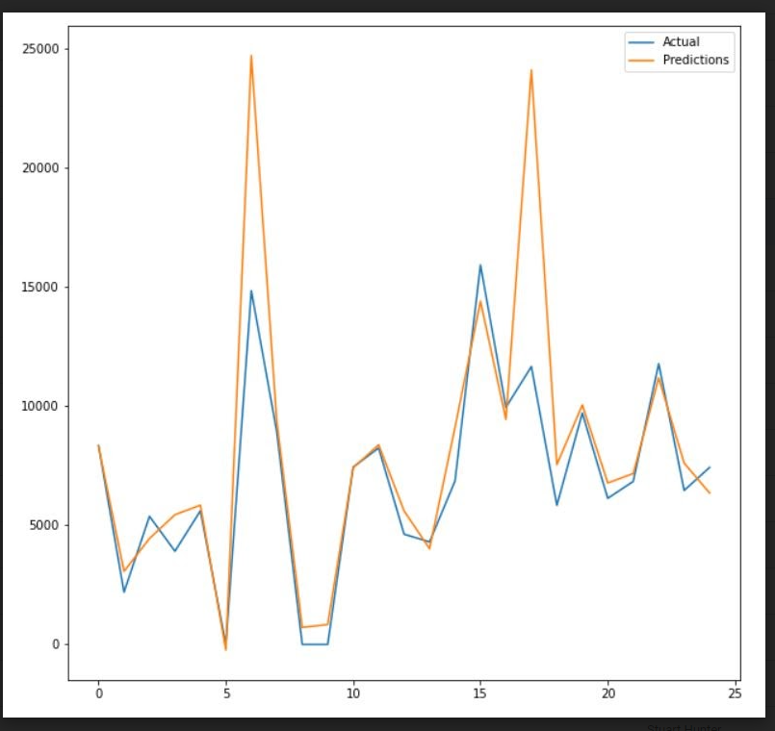
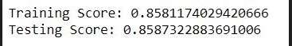
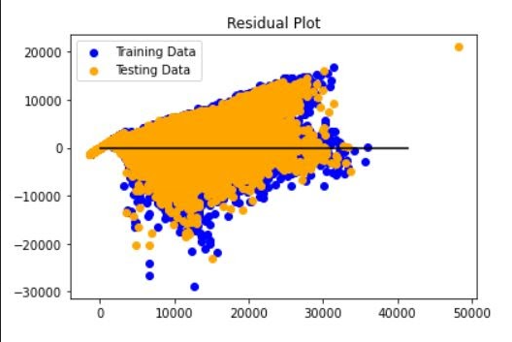
Multiple Linear Regression

Slide 13
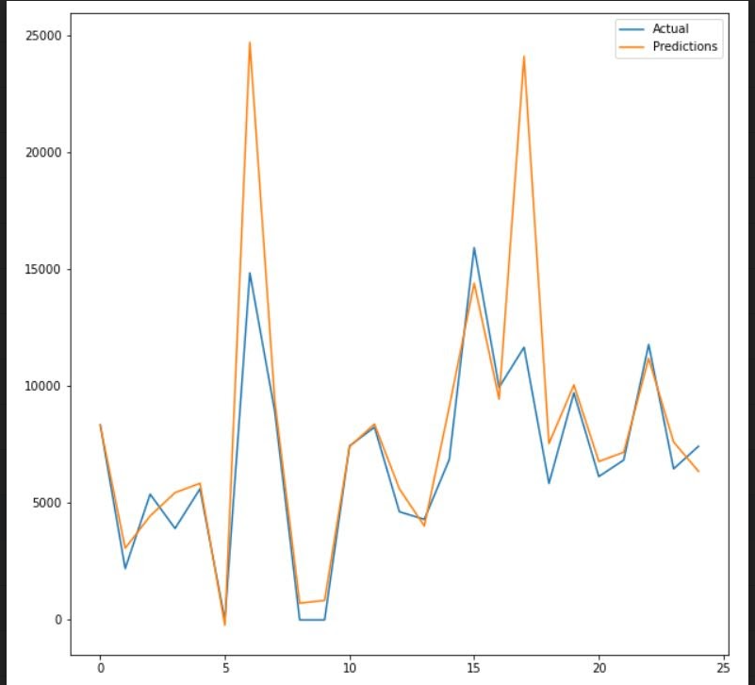
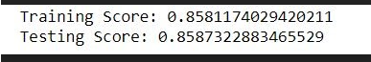
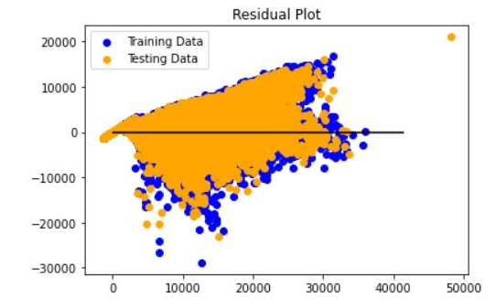
Ridge Model

Slide 14
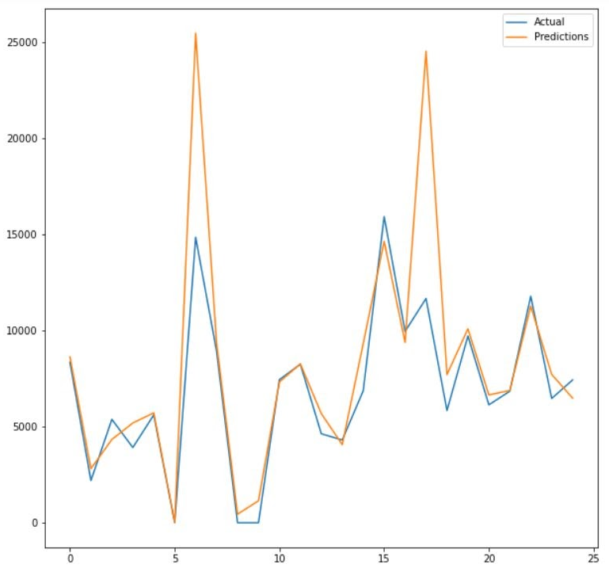
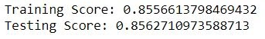
ElasticNet Model

Slide 15
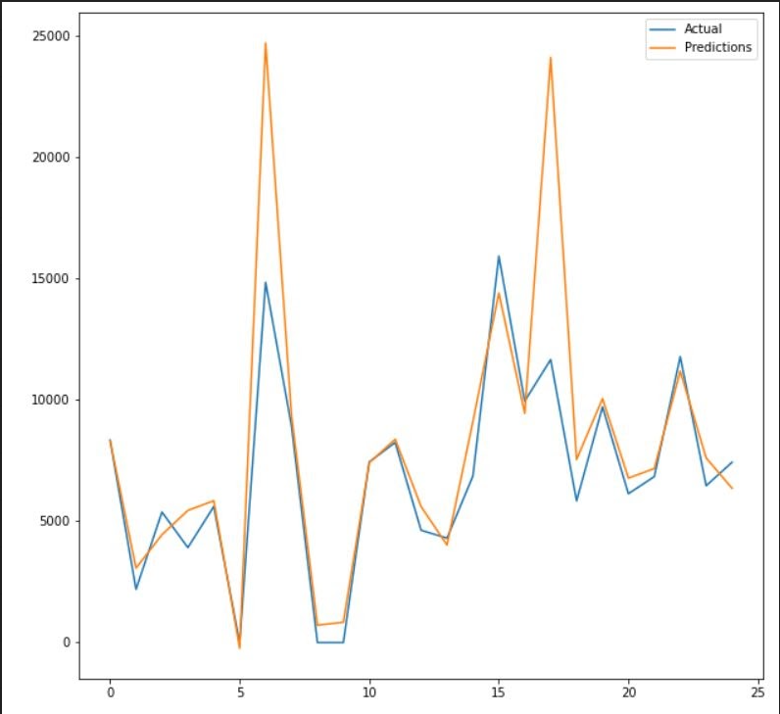
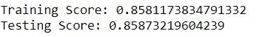
Lasso Model

Slide 16
Regression Model Analysis
Utilized the model.score method to evaluate and contrast models & residual plots where available
The residual plots worked for the Multiple Linear Regression and Ridge models only, due to an unresolved “memory error”
The two residual plot distributions were not perfect in terms of symmetrical distribution and absence of clear patterns
The models do answer our central questions: to analyze and predict sales
Notes:
(note: R-squared gives the overall model score, using model.score on testing data; therefore, testing score and R2 are interchangeable here)
Note: when the data was not scaled training scores were included in the evaluation; when the data was preprocessed with StandardScaler, instead we looked at the mean squared error in our evaluation
Conclusion on StandardScaler: it did not affect the model score in a meaningful way, regardless of the model used

Slide 17
SGD Regressor Model

Slide 18
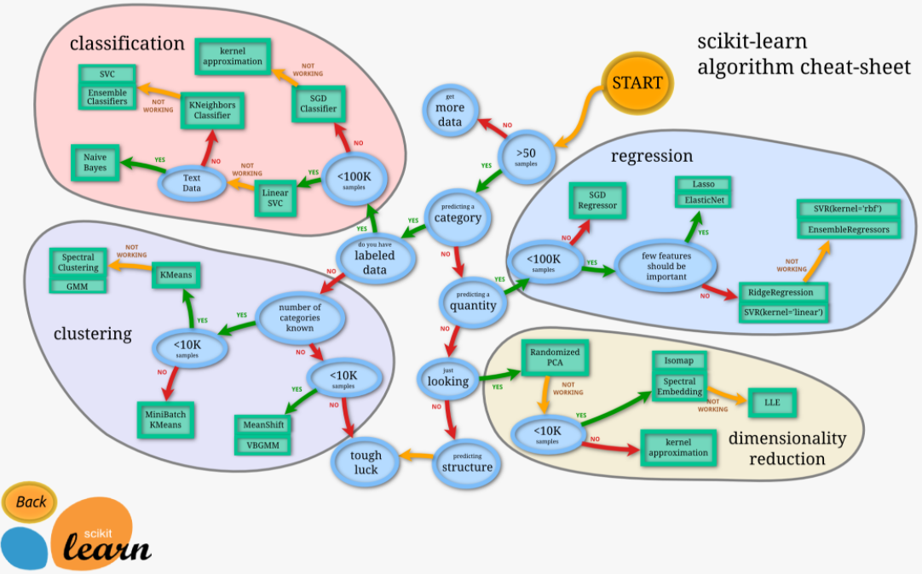

Slide 19
SGD Regressor Model
Followed the schematic map path for predicting a quantity with a data set containing more than 100,000 samples
Our data set >1,000,000 samples
StandardScaler was used to scale the dataset
Notes:
stochastic gradient descent

Slide 20
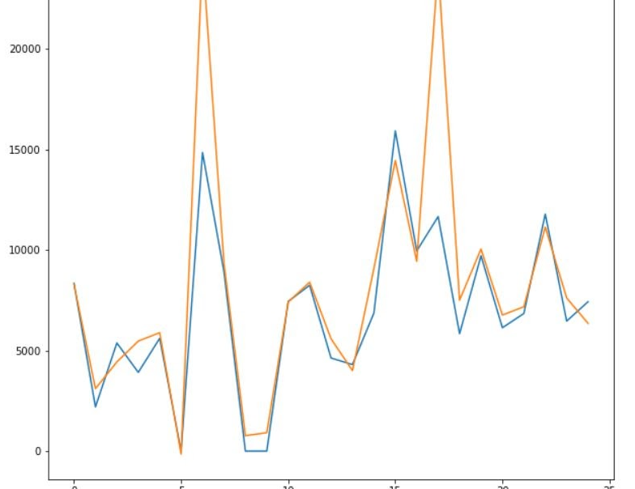
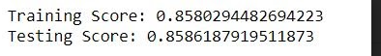
SGD Regressor Model

Slide 21
LightGBM Regressor Model
Exploring different ways that other analysts’ work have utilized regression models to predict future sales, we focused on a machine learning framework originally developed by Microsoft
LightGBM (Light Gradient Boosting Machine)
Define as a gradient boosting framework” for “regression and classification problems” based on “decision tree algorithms”
The LightGBM “regressor model” has many possible parameters
“Maximum tree leaves for base learners” (num_leaves)
“Maximum tree depth or base learners” (max_depth)
“Subsample ration of the training instance” (subsample)
“L1 regularization term on weights” (reg_alpha), etc.
Notes:
As define by Wiki pages

Slide 22
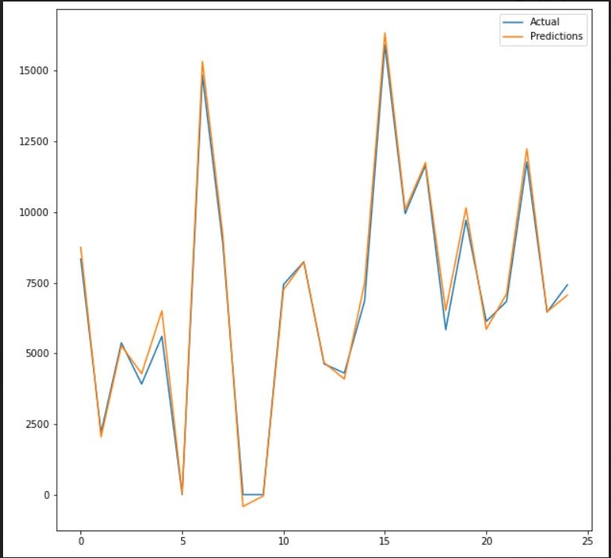
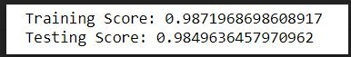
LightGBM Regressor Model
Best score of all models tested!

Slide 23
Conclusions
LightGBM model provided the best score out of all the models tested
Regardless of the model utilized to make predictions, given a set of twelve featured data points we can use model.predict() to predict sales

Slide 24
Questions?
Thank you!

